Slide 1

Project Proposal of
DIU CHATBOT
BY
TEAM MIRAGE

Slide 2
Team Members
MD TAZRIAN ALAM
221-15-5866
SUNZIL KHANDAKAR
221-15-5383
MEHEDI HASAN
221-15-4866

Slide 3
Table of Content
Project Overview
Software We Use
Project Feature
Data We Collect
Font End Design
Back-End Implemantation
Project Methodological Diagram
Advantage
Disadvantage
Future Scope

Slide 4
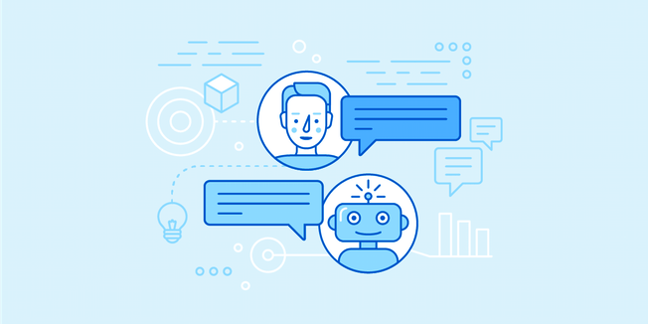
Project Overview
Our project name is DIU CHATBOT.
Diu Chatbot is an assistant that will help students, parents, and other people to get information about Daffodil International University (admission, faculty, location, etc.), which will support them 24/7 to know about DIU.
This Photo by Unknown Author is licensed under CC BY-SA

Slide 5

Platform We Use
GOOLE COLABORETORY

Slide 6
Data We Collect
What WE Collect:
We collect About All information of Daffodil International University Such As:
Admission Information
Payment Information
Transport Information
DIU Club Information
Weiver Information
Department Information
DIU Places like ( Bonomaya, Hall, Library)
Online Portal Information
Exam Information
How WE Collect:
We collect these information through Visiting these Places and through out DIU Website
Medium of Data:
Bangla
English

Slide 7
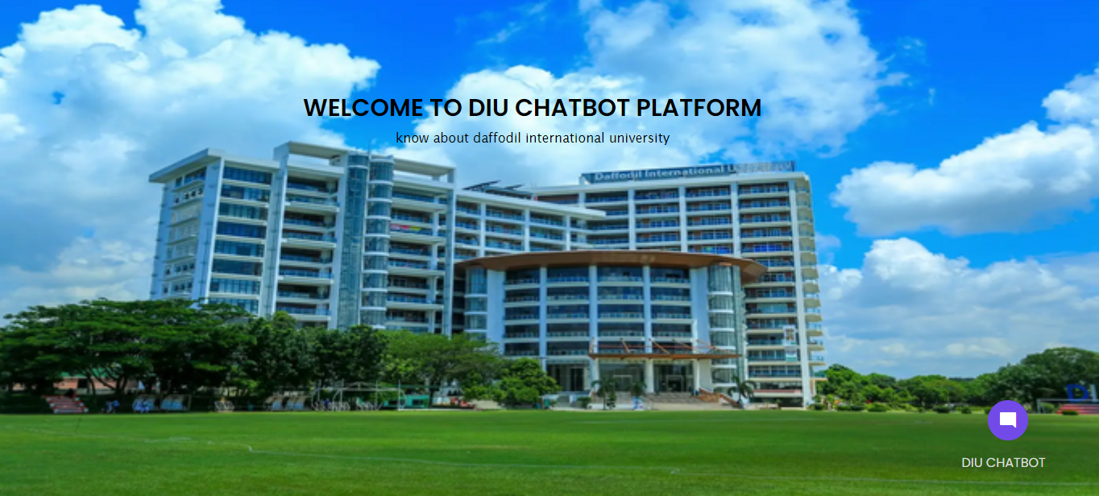
Font End Design(Index)

Slide 8
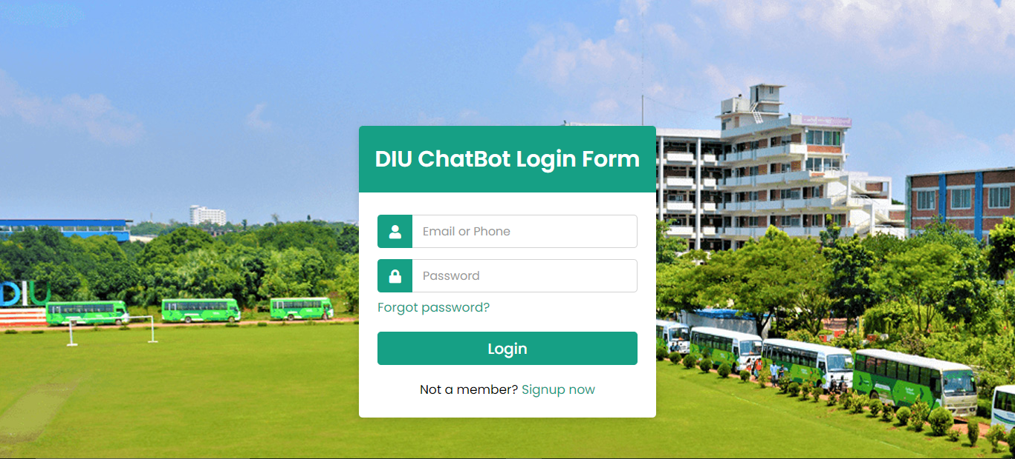
Font End Design(Login Page)

Slide 9

Font End Design(ChatBoT)

Slide 10
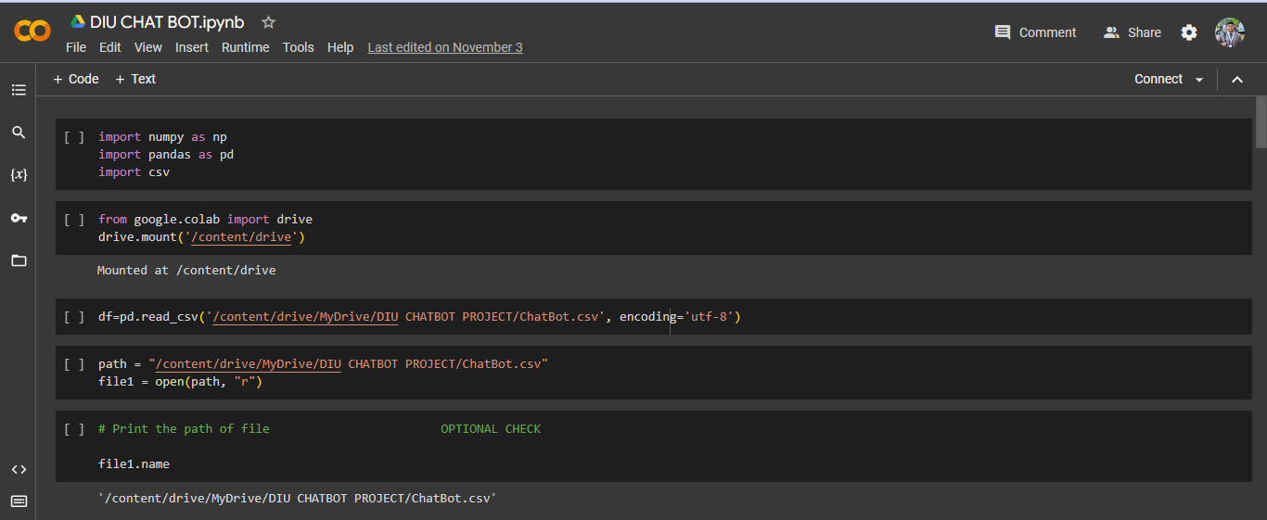
Back-End Implemantation

Slide 11
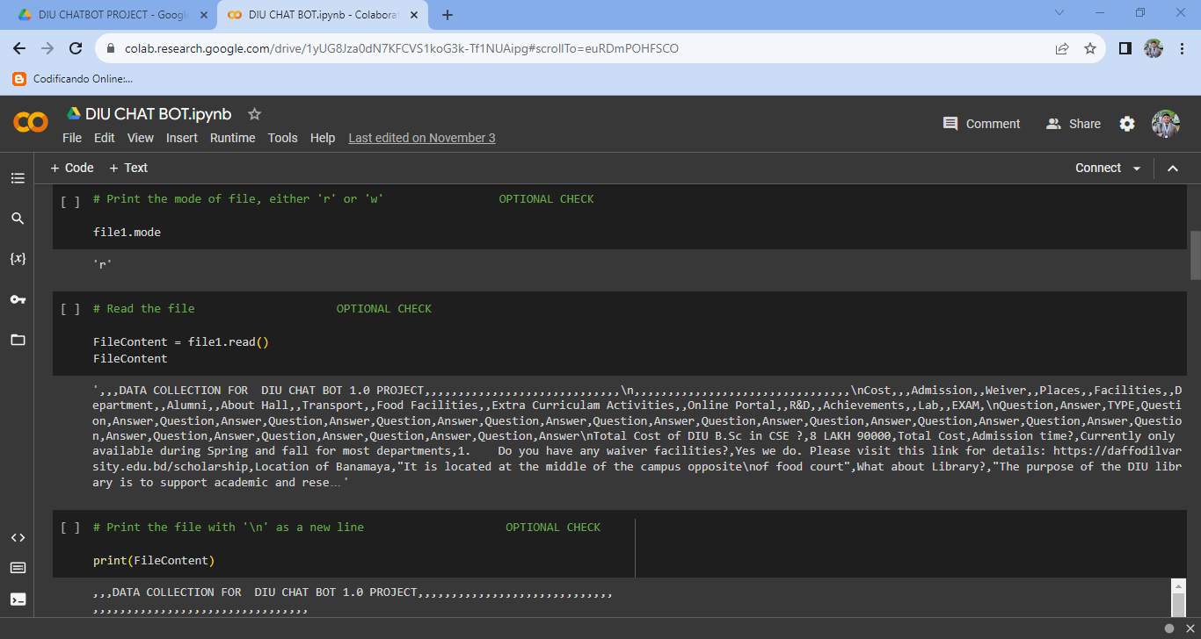
Back-End Implemantation

Slide 12
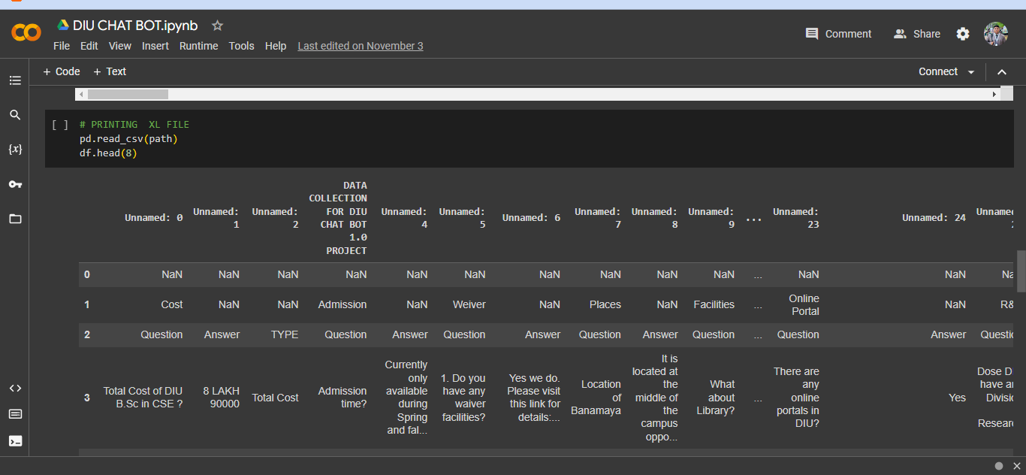
Back-End Implemantation

Slide 13
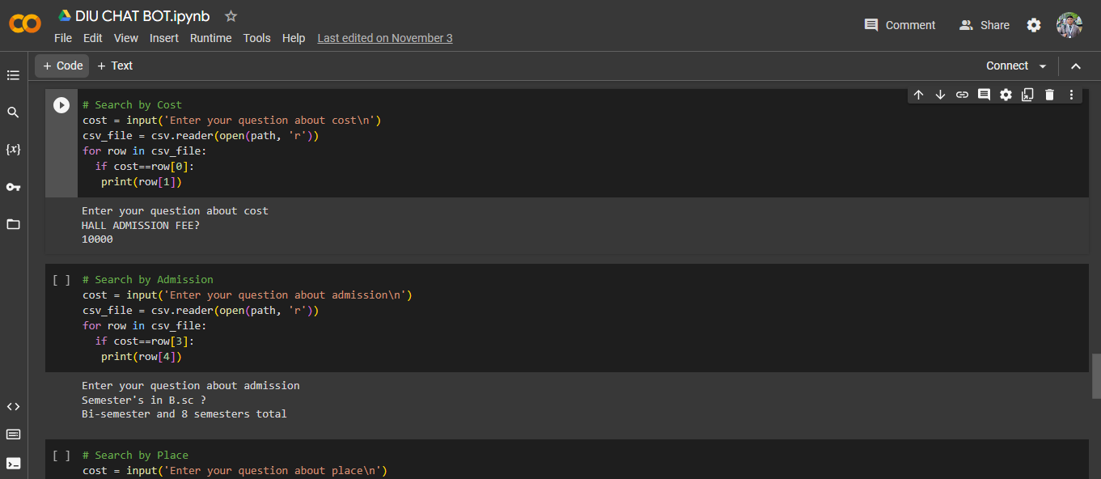
Back-End Implemantation

Slide 14
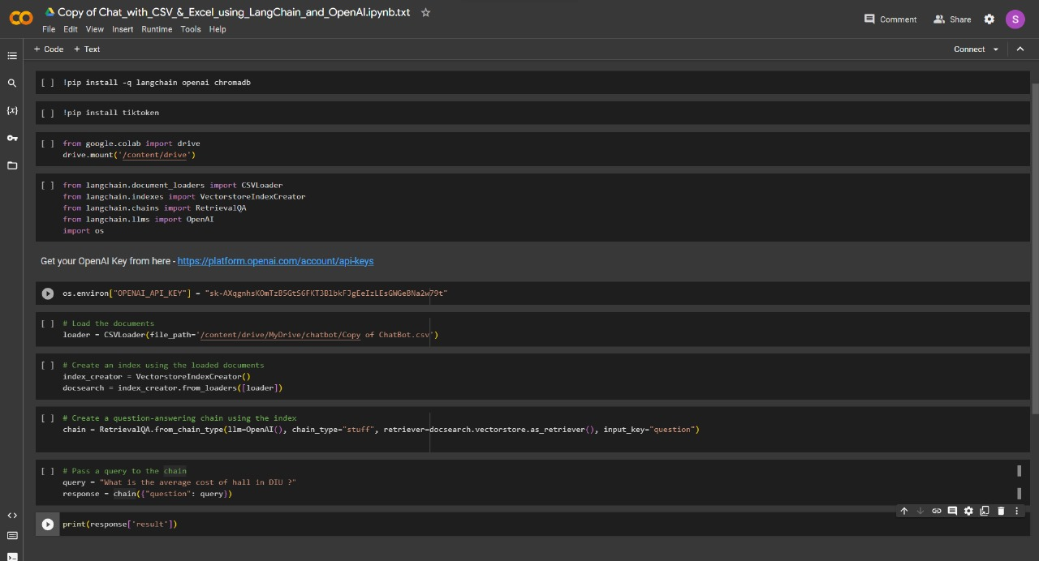
Back-End Implemantation(Expected)

Slide 15
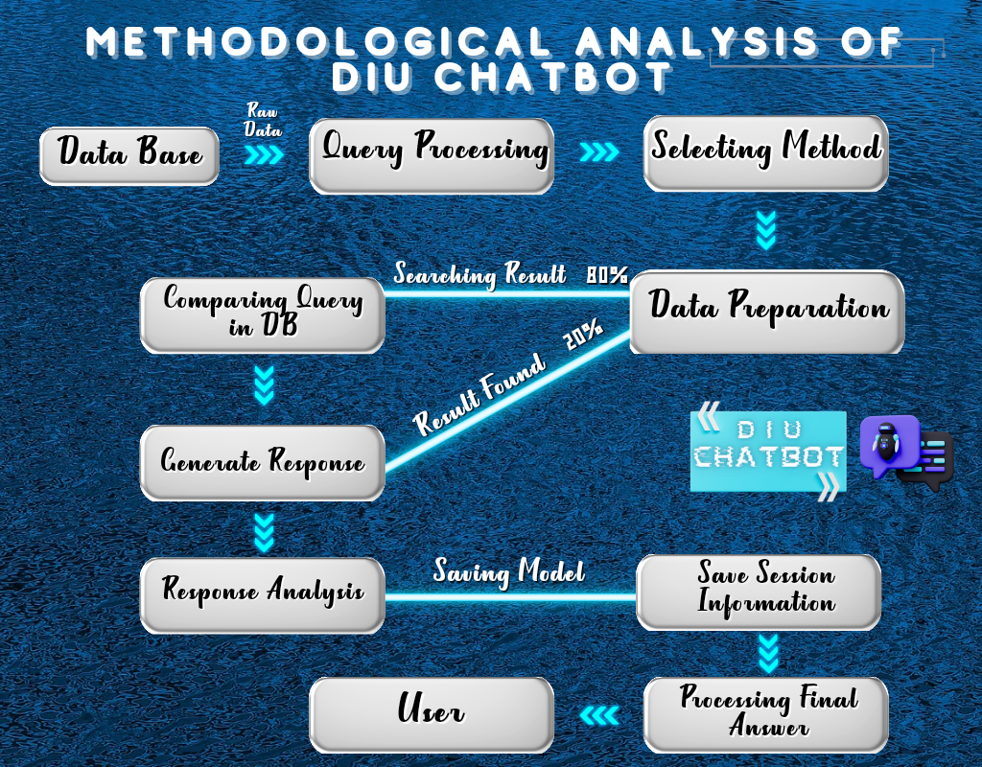
Project Methodology

Slide 16
Advantage:
24*7 Availability
Reduce Errors
Reduces Operational Costs
Increases Engagement
Lead Generation
ADVANTAGE

Slide 17
Disadvantage:
Less Understanding of Natural Language
Higher Misunderstanding
Needs Analyzing
DISADVANTAGE

Slide 18
Future Scope:
Implement natural language processing (NLP) techniques to improve the chatbot's ability to understand and respond to user queries in a more natural and engaging manner.
Develop the chatbot's ability to communicate in multiple languages, catering to a wider audience and enhancing its global accessibility.
Implement user profiles to store personal preferences, interests, and past interactions, allowing the chatbot to provide tailored responses and recommendations.
FUTURE SCOPE

Slide 19
Thank You

